Slide 1
Session 3
Olivia Milholland, Katie Varela, Denise Cunillera
(Information provided by Ms. Davis)

Slide 2
Welcome! (get out a pen/piece of paper)
Take notes on this presentation and keep them in your Portfolio under classwork.
You will use these notes to help you with your mentoring this year.

Slide 3
THE BEST MODEL
B- BUILDING
E- ENHANCING
S- SUSTAINING
T-TRANSITIONING
When making a relationship with your mentee you want to follow the steps of BEST. This model you want to get to know your mentee by introducing yourself and finding thing in common. Then you enhance the mentor relationship by helping them with goals and be someone they can ask questions to about school. You then want to sustain the relationship by working on your mentees goals together. When transitioning out of the mentoring relationship you want to make sure you leave on good terms and have closure from the relationship.

Slide 4
Building
Naturally, you and your mentee will be nervous at the beginning. This is OK! Since the relationship is still fragile, it is important that you stay consistent, authentic, and open minded!
During your first meeting, you will:
Introduce yourself with confidence and a smile!
Learn how to pronounce your mentee’s name
Tell your mentee about yourself
Get to know your mentee a little bit
Remain positive and end on a good note!
Your mentee may take a while to warm up to you. Be patient, nonjudgmental, and open!

Slide 5
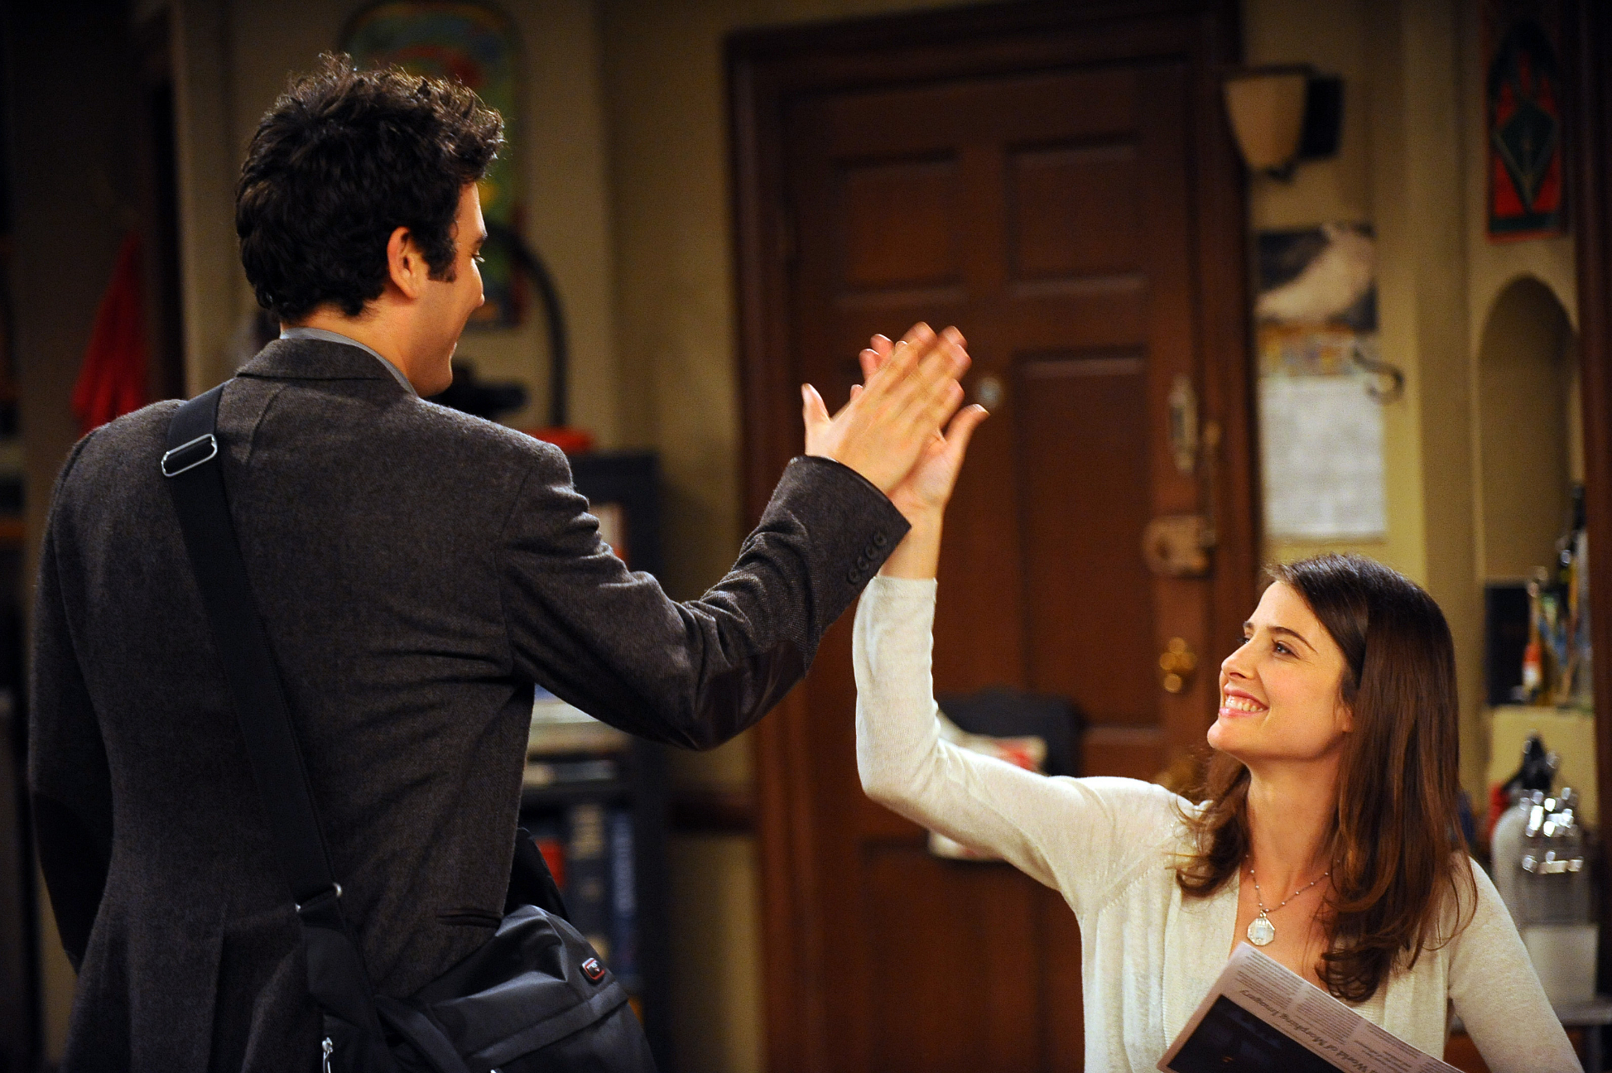
Enhancing
Explore interests, set goals, offer yourself as a reliable resource to your mentee.
Goals can be personal, academically centered, career oriented, etc.
Take time to listen to your mentee and their aspirations.
Don't impose your goals/vocations onto them.

Slide 6
Your Turn!
Write down/share with your team one way you can enhance your relationship with your mentee.

Slide 7
Sustaining
How to detect a stable healthy relationship: The relationship should be
Comfortable
Personal
Open
While this new level of comfort is wonderful, it also might come with some new challenges. You and your mentee may struggle to live up to the expectations you agreed to at the start of the relationship. If this happens, you might re-negotiate the terms of your relationship by reviewing accomplishments and new goals.

Slide 8
Transitioning
Change is scary but being prepared helps.
Be sure to communicate with your mentee about change.
Commemorate what was accomplished and how much time abides.
Convey where your relationship with your mentee stands once the program ends.
No matter what you decide, make sure to give your mentee closure.
Confirm that you both come to a general understanding.

Slide 9
Reflection Meet with your Team and Discuss
Considering what we’ve covered today, what takeaways do you have? How do you see the topics from today working together to help you as you peer mentor?
Discuss your responses with your team.
Email Ms. Davis (khea.davis@sarasotacountyschools.net) telling her how the BEST Model will help you as a peer mentor.

